Slide 1
Visual Studio 2017
Install and tutorial

Slide 2
Install Visual Studio 2017

Slide 3
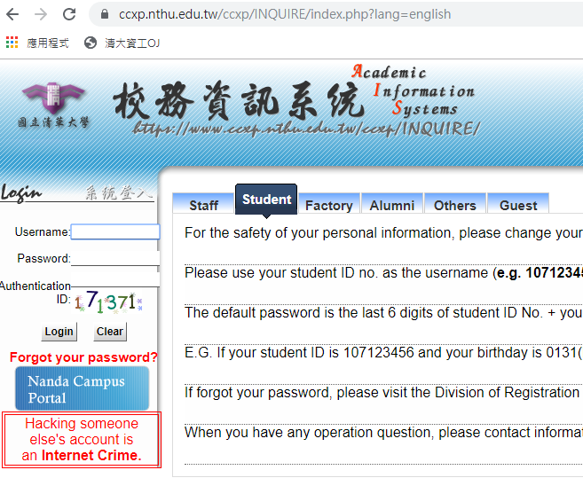
Install Visual Studio 2017
Step1: Enter academic information system
https://www.ccxp.nthu.edu.tw/ccxp/INQUIRE/index.php?lang=english
Fill in username and password

Slide 4
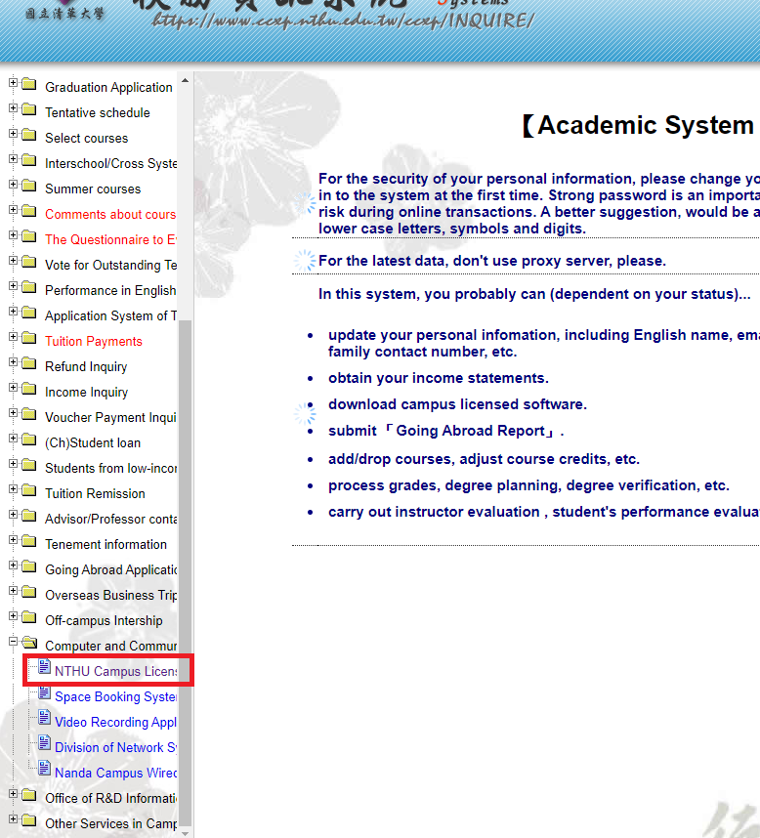
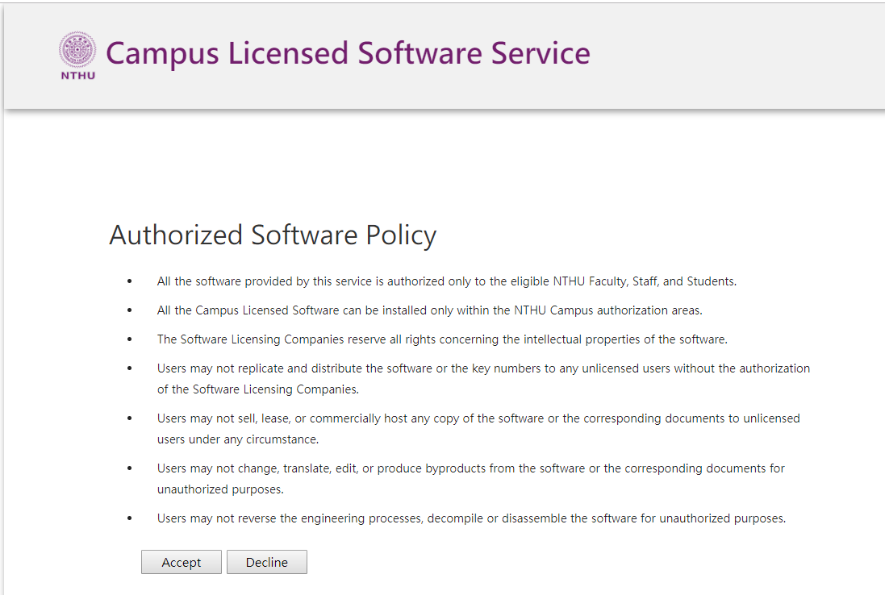
Install Visual Studio 2017
Step2: Enter NTHU Campus Licensed Software Service

Slide 5
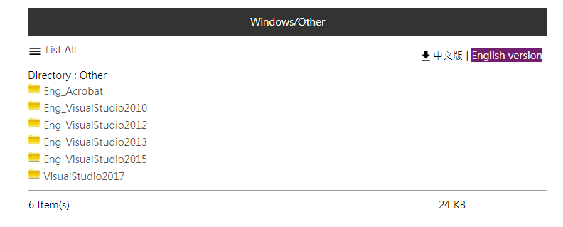
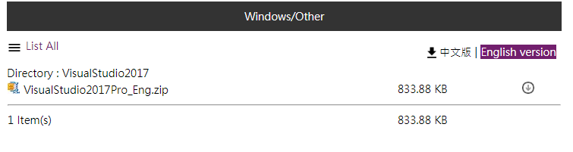
Install Visual Studio 2017
Step3: Find Visual Studio 2017 and download it

Slide 6
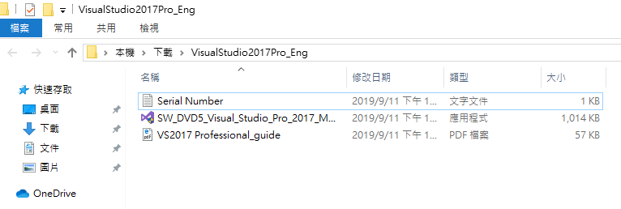
Install Visual Studio 2017
Step4: Unzip folder and click to install

Slide 7
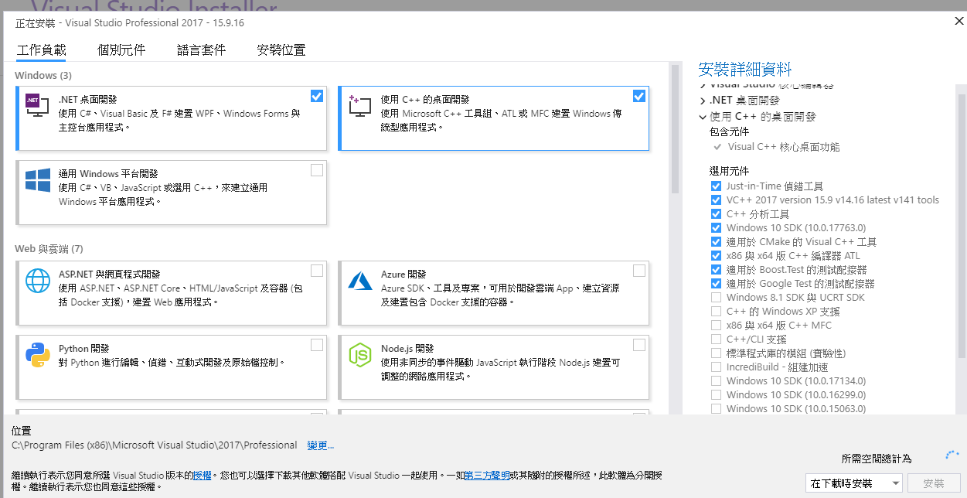
Install Visual Studio 2017
Step5: Check .NET and C++ package

Slide 8
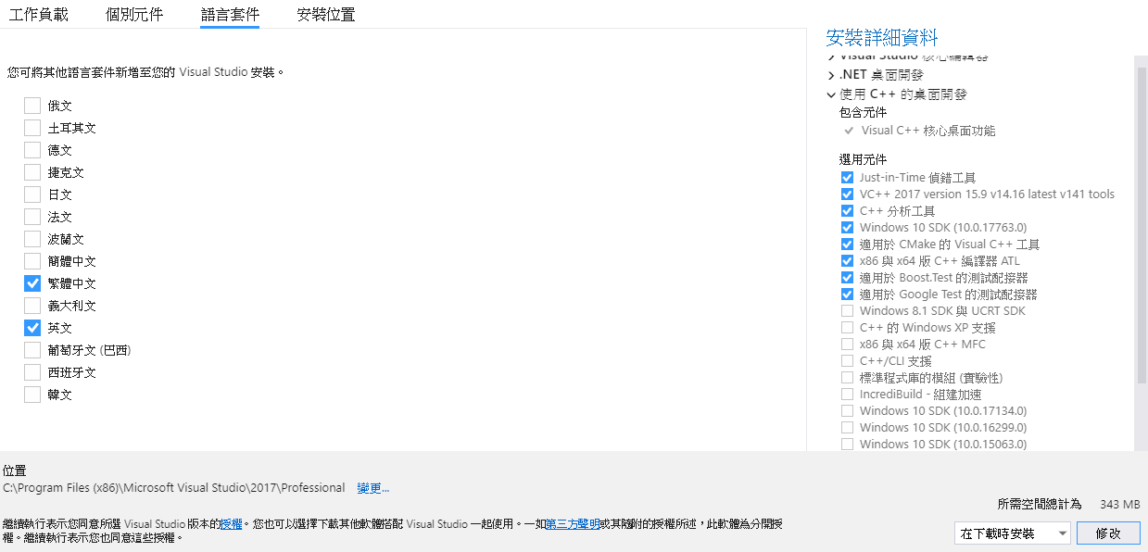
Install Visual Studio 2017
Step6: Select language
Chinese
English
Install

Slide 9
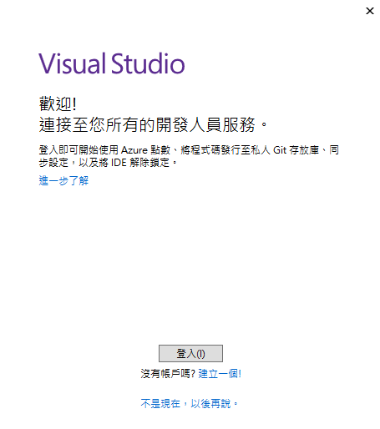
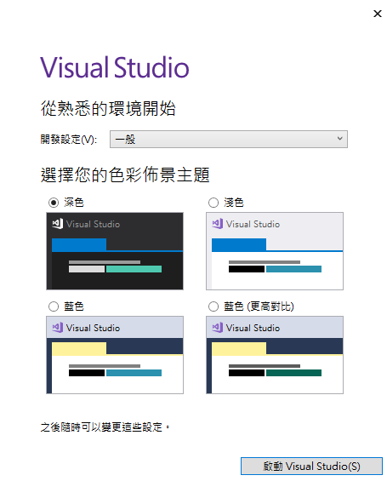
Install Visual Studio 2017
Step7: Open Visual Studio 2017 and setup environment

Slide 10
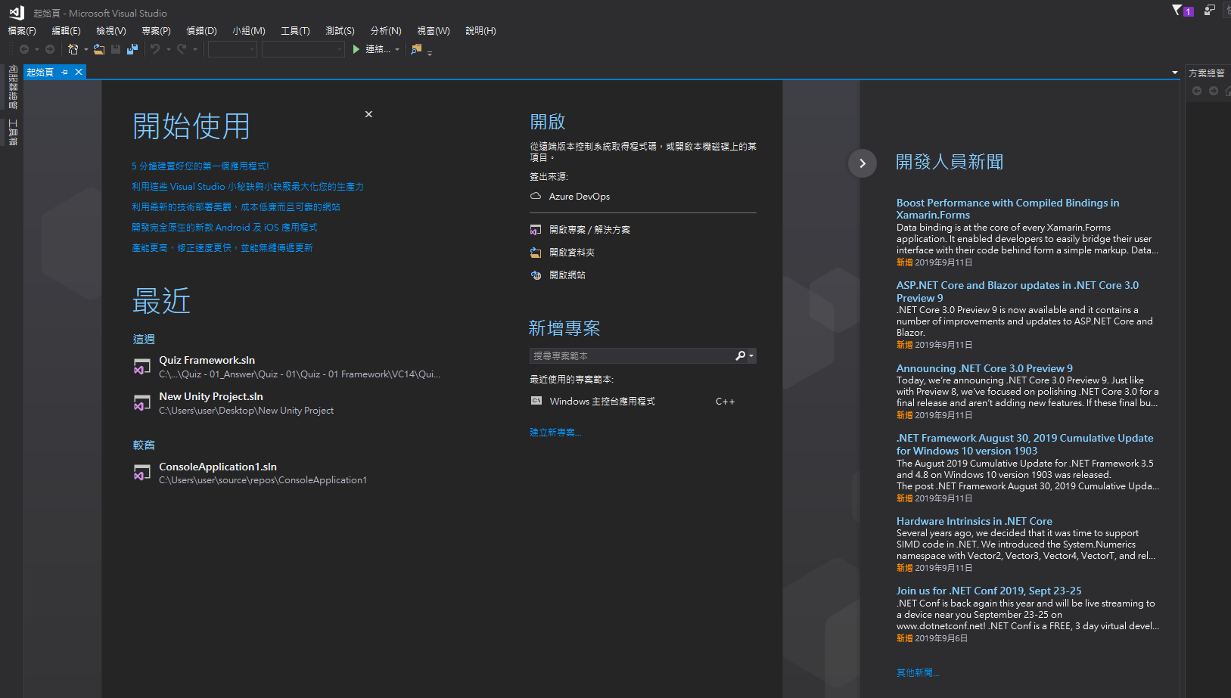
Install Visual Studio 2017
Final result

Slide 11
Change Language

Slide 12
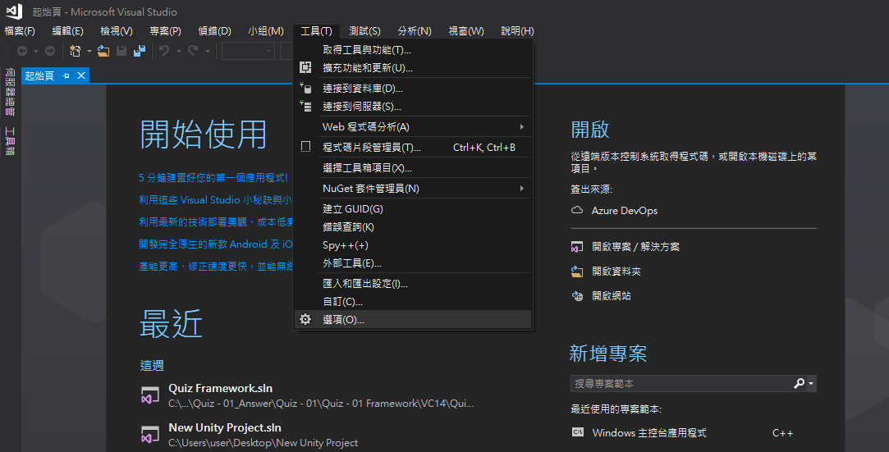
Change Language
Step1: Click tool page and enter setting window

Slide 13
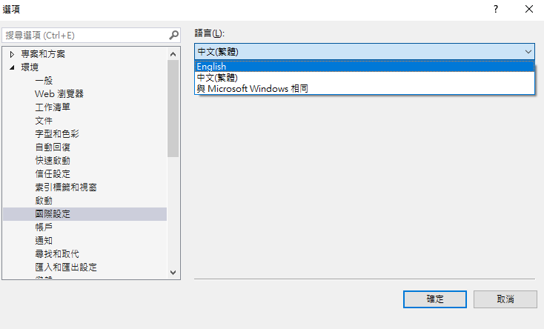
Change Language
Step2: Select English language
2.
1.
3.

Slide 14
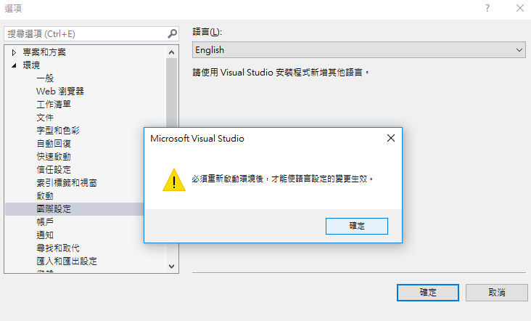
Change Language
Step3: Restart visual studio 2017

Slide 15
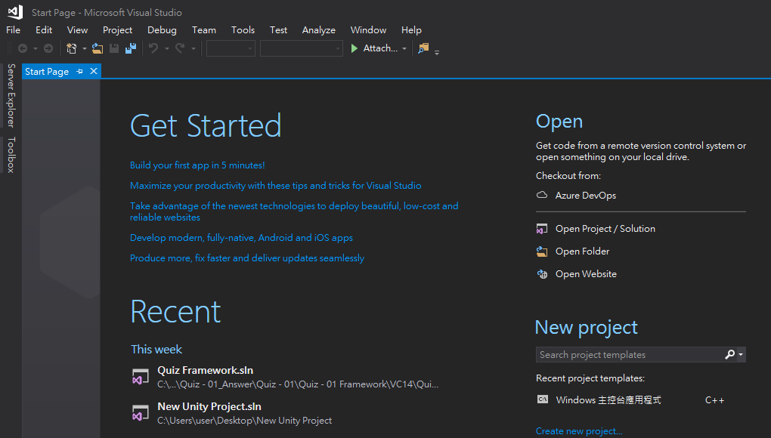
Change Language
Final Result

Slide 16
Visual Studio 2017 Usage

Slide 17
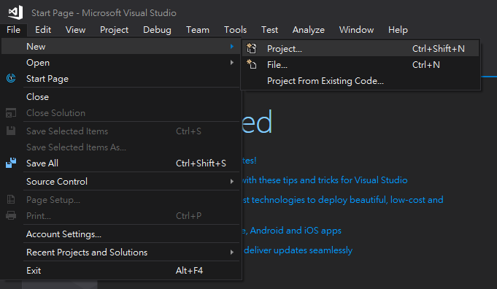
Visual Studio 2017 Usage
Step1: Create new project

Slide 18
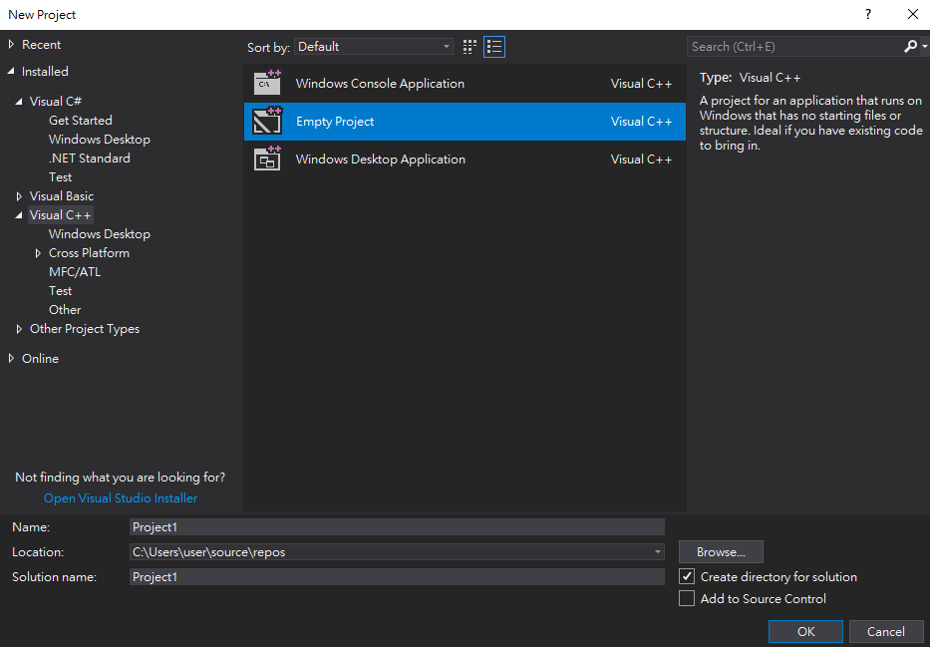
Visual Studio 2017 Usage
Step2: Select C++ empty project
1.
2.
3.

Slide 19
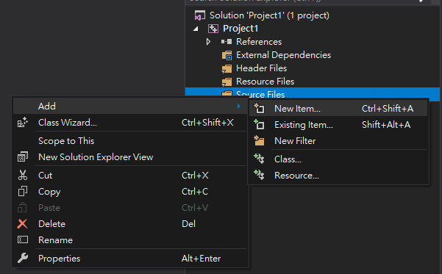
Visual Studio 2017 Usage
Step3: Create new item to write programs (part1)
right click “Source Files”
2.
3.

Slide 20
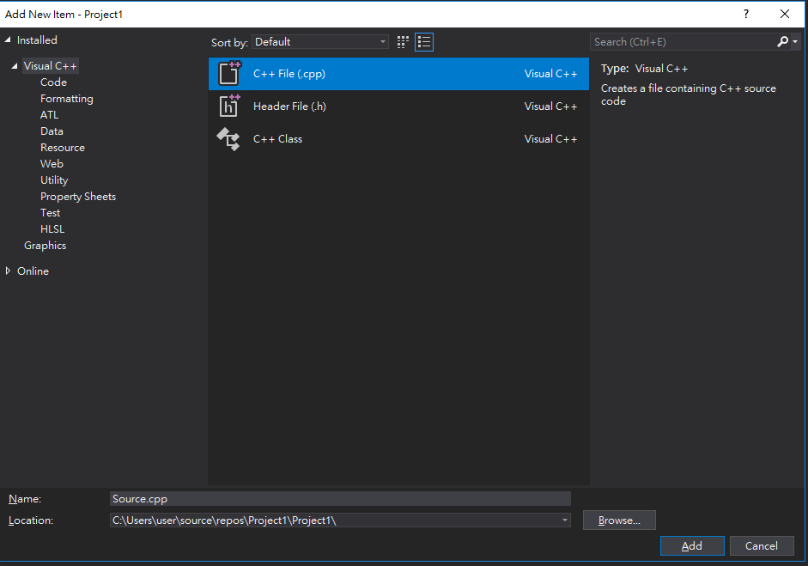
Visual Studio 2017 Usage
Step3: Create new item to write programs (part2)
1.Select C++ File
2.

Slide 21
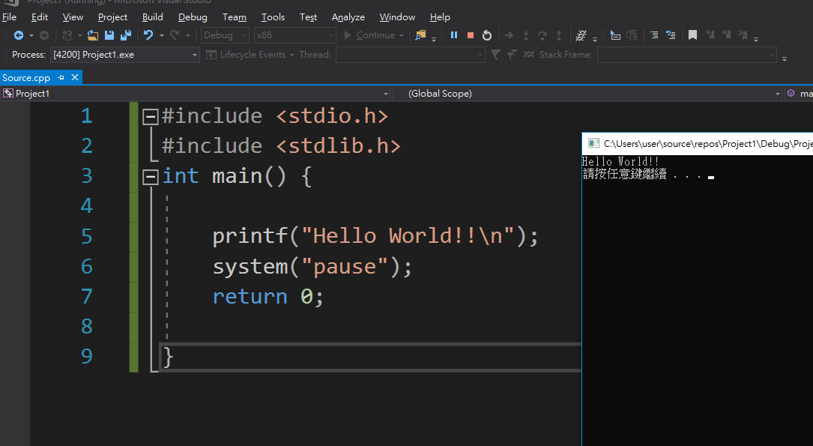
Visual Studio 2017 Usage
Step4: Write program and execute (ctrl + F5 / click green arrow)

Slide 22
Enjoy to program your code!

